Slide 1

Presentation Title
Face Recognition with Micro:bit & Ting:bit Robot
reporter
Jiarui Huang
时间：2025.01.01

Slide 2



目录
01
Agile Process Documentation
02
Face Recognition Implementation
03
Final Source Code
04
Conclusion
05
敏捷流程文档
06
面部识别实现

Slide 3

PART01
Agile Process Documentation

Slide 4



SCRUM Process Overview
01
SCRUM Planning
The project adopts a 5-day SCRUM cycle, divided into two sprints. The first sprint includes tasks like planning steps, writing user stories, creating a burndown chart, and documenting the Agile section. The second sprint focuses on building the robot, displaying images, recognizing faces, protecting data, and completing a video and report.
02
User Stories
User stories cover building a Micro:bit robot, recognizing different faces, displaying numbers on the LED matrix, linking faces with numbers, creating a burndown chart for progress monitoring, and documenting the Agile process.
03
Agile Report Writing
The Agile section of the report meticulously documents the entire development process, including task completion and team collaboration, providing a clear record of the project workflow.

Slide 5
PART02
YOUR LOGO
Face Recognition Implementation

Slide 6


Introduction
Project Background
In recent years, the integration of AI and embedded systems has garnered significant attention, especially in educational and prototyping environments. This project aims to develop a two-wheeled mobile car capable of facial recognition using the tiny-bit smart car kit and the Micro:bit microcontroller.
Project Goals
The project explores the feasibility of implementing facial recognition on a resource-constrained platform and evaluates the robot’s performance and behavior in dynamic environments.

Slide 7



Task Implementation
Building the Robot
Displaying Images on LED Matrix
Recognizing Faces
Assemble the car body with two tires, a caster wheel, and a central battery. Insert the Micro:bit development board into the designated slot. Install an adjustable-angle bracket and fix the K210 visual recognition module onto it.
Write code to control the Tiny:bit and Micro:bit activities. Use a variable to store face states and display face numbers on the LED matrix. Deploy the code to the Micro:bit controller to enable face recognition.
Point the camera at a face; new faces show a white border, while recorded faces show a green border. The system prompts users to record unregistered faces.

Slide 8
PART03
YOUR LOGO
Final Source Code

Slide 9

Code Overview
Code Structure
Deployment Process
The code includes initialization, music settings, face state variables, and loop detection and display logic. It runs on the Micro:bit controller to achieve facial recognition and LED matrix display functions.
Connect the Micro:bit controller to a laptop and upload the code. Once deployed, the robot can perform facial recognition.

Slide 10
Git Command History
Version Control
Git commands are used to track code version history, facilitating team collaboration and ensuring the traceability of the development process.

Slide 11
PART04
YOUR LOGO
Conclusion

Slide 12

Project Summary
Achievements
Future Work
The project successfully implemented facial recognition using a Micro:bit and Ting:bit robot, demonstrating the potential of combining embedded systems with AI.
Future work includes optimizing the facial recognition algorithm, enhancing robot performance in complex environments, and exploring more application scenarios.

Slide 13
PART05
YOUR LOGO
敏捷流程文档

Slide 14
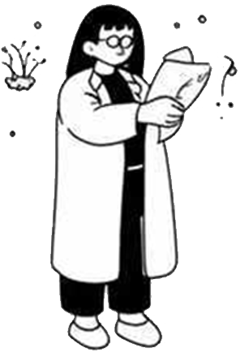
SCRUM流程概览
SCRUM计划
项目采用5天的SCRUM周期，分为两个冲刺阶段。第一阶段包括计划步骤、编写用户故事、创建燃尽图和撰写敏捷部分报告。第二阶段包括构建机器人、显示图像、人脸识别、保护数据以及完成视频和报告。
用户故事
用户故事涵盖构建Micro:bit机器人、识别不同面孔、在LED矩阵上显示数字、将面孔与数字关联、创建燃尽图以监控进度以及记录敏捷流程。
敏捷报告撰写
敏捷部分的报告详细记录了整个开发过程，包括任务完成情况和团队协作，为项目流程提供了清晰的记录。

Slide 15
PART06
YOUR LOGO
面部识别实现

Slide 16
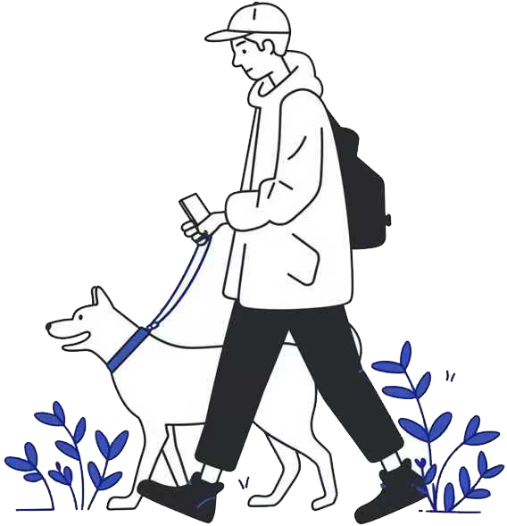
引言
01
项目背景
近年来，人工智能与嵌入式系统的结合受到了广泛关注，尤其是在教育和原型开发环境中。本项目旨在开发一个能够进行人脸识别的两轮移动小车，使用tiny-bit智能小车套件和Micro:bit微控制器。
02
项目目标
项目探索在资源受限的平台上实现人脸识别的可行性，并评估机器人在动态环境中的性能和行为。

Slide 17
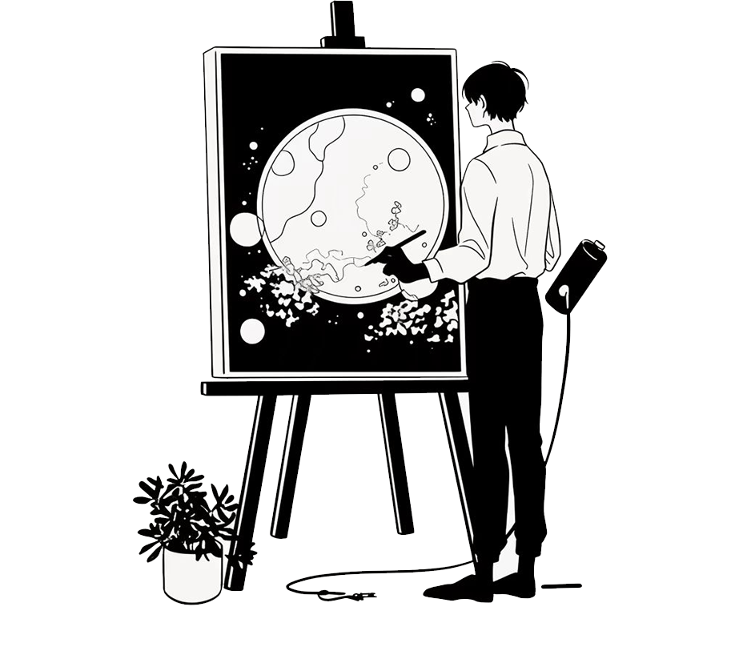
任务实现
构建机器人
组装车体，包括两个轮胎、一个万向轮和中央电池。将Micro:bit开发板插入指定插槽。安装可调节角度的支架，并固定K210视觉识别模块。
在LED矩阵上显示图像
人脸识别
编写代码以控制Tiny:bit和Micro:bit的活动。使用变量存储面孔状态并在LED矩阵上显示面孔编号。将代码部署到Micro:bit控制器以启用面部识别。
将摄像头对准面孔；新面孔显示白色边框，而已记录的面孔显示绿色边框。系统提示用户记录未注册的面孔。

Slide 18
PART07
YOUR LOGO
最终源代码

Slide 19

代码概览
代码结构
代码包括初始化、音乐设置、面孔状态变量以及循环检测和显示逻辑。它在Micro:bit控制器上运行，以实现面部识别和LED矩阵显示功能。
部署过程
将Micro:bit控制器连接到笔记本电脑并上传代码。部署完成后，机器人可以执行面部识别。

Slide 20
Git命令历史
版本控制
使用Git命令跟踪代码版本历史，便于团队协作并确保开发过程的可追溯性。

Slide 21
PART08
YOUR LOGO
结论

Slide 22
项目总结
成就
项目成功实现了使用Micro:bit和Ting:bit机器人的面部识别，展示了嵌入式系统与人工智能相结合的潜力。
未来工作
未来的工作包括优化面部识别算法、提高机器人在复杂环境中的性能以及探索更多的应用场景。

Slide 23
YOUR LOGO
Presentation Title
THANKS!
汇报人：Kimi
时间：2025.01.01

